Slide 1

A STEP TOWARDS SMART RATION SYSTEM USING RFID & IOT
KIRAN KARTHIKEYAN
FIT20MCA-2067

Slide 2


Slide 3
Relevance
The present ration distribution framework has downsides like wrong amount of products, low processing speed, and large wait in time, material theft in ration shop. The proposed framework replaces the manual work in proportion shop. The principle goal of the planned framework is the robotization of ration shop to give straightforwardness.
To overcome the problems mentioned, Smart Rationing system plays a vital role

Slide 4
Description
The proposed automatic ration shop for public distribution framework is based on Smart Automating rationing system that replaces ordinary ration cards.
Fingerprint sensor is used for identification.
The proposed distribution framework has the ability to overcome disadvantages of the existing system like wrong amount of products, low processing speed, and large wait in time, material theft in ration shop.
The principle goal of the planned framework is the automation of ration shops to give straightforwardness.

Slide 5
Description
Main goal of the planned system is the real time authentication of the consumer and automation of material distribution in ration shop.
I propose to design a smart rationing system in which the authentication is based on Smart ration card that replaces the present paper based ration card. Here the RFID tag act as smart card which consist of all the details about the card holder
Customer needs to scan RFID Tag on RFID reader, which is followed by fingerprint scanning and then microcontroller checks customer’s details with stored to distribute material in ration shop.

Slide 6
Description
After successful verification, customers need to enter type of material as well as quantity of material using keypad the material get automatically displayed in LCD display and commodities are dispatched without manual interpretation. Once the commodities are dispensed, the microcontroller sends the information to customer through IoT technology.

Slide 7
Objectives
The project smart Rationing system propose to develop a system which enable the real time authentication of the consumer and automation of material distribution in ration shop.
I propose to design a smart rationing system in which the authentication is based on Smart ration card that replaces the present paper based ration card.
Fingerprint module and RFID module is interfaced to the Arduino Microcontroller through serial port.
The user scans the smart card, which is then verified using a stored data.
It is followed by Fingerprint identification to verify the identity of the user. The fingerprint scanner acts as a level 2 authentication to stop any fraudulent activity.

Slide 8
Objectives
After successful verification customers need to enter type of material and quantity of material using keypad the material get automatically dispatch without manual interpretation.
After delivering proper materials to consumer the microcontroller sends information to customers through IoT technology. The customer can also track the history of their past consumption using app.

Slide 9
Objectives
The main objective is to have a completely automated system with no human intervention resulting in 24x7 Operation like ATM Machine, automatic Ration distribution with a mechanized dispensing assembly, corruption and Forged Ration delivery problems minimized to a large extent, Two level online real-time authentication of consumer (RFID based Smart Card, biometric),the consumer database (app) will be updated after each transaction, Once commodities are dispensed the information will be sent to the consumer and there is alerted in case of theft or malpractice.

Slide 10
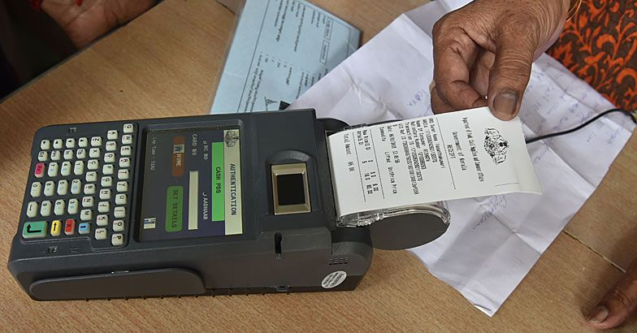
Existing System
EPOS machine is the system using now in ration shop

Slide 11
WORKING OF EXISTING SYSTEM

Slide 12

Disadvantage
Issue faced by the common people is about the unavailability of goods which usually happens due to the illegal smuggling of the goods by the ration shop workers and dealers of that particular locality
inaccurate measuring of the goods by the ration shop workers knowingly or unknowingly
Over crowd
Poor quality of supplies
Cannot able to get the material at any time
If stock is finished user want to come and check to the shop

Slide 13
Proposed System
The present ration distribution framework has downsides like wrong amount of products, low processing speed, and large wait in time, material theft in ration shop. The proposed framework replaces the manual work in proportion shop. The principle goal of the planned framework is the robotization of ration shop to give straightforwardness.
This system helps to maintain the data properly
Cost effective approach
Time saving approach
Getting alert from the ration system

Slide 14
Components Used
Arduino Uno – Atmega328p
LCD Display
Fingerprint Sensor
Keypad
Buzzer
Node MCU
RFID Tag & Reader
Servo Motor & Water pump
Ultrasonic Sensor

Slide 15
NOW LET’S SEE THE WORKING OF THE MODEL

Slide 16
Future Scope
For authentication can able to use face recognition , pins
Make all the process from mobile application
Quality check of the product

Slide 17
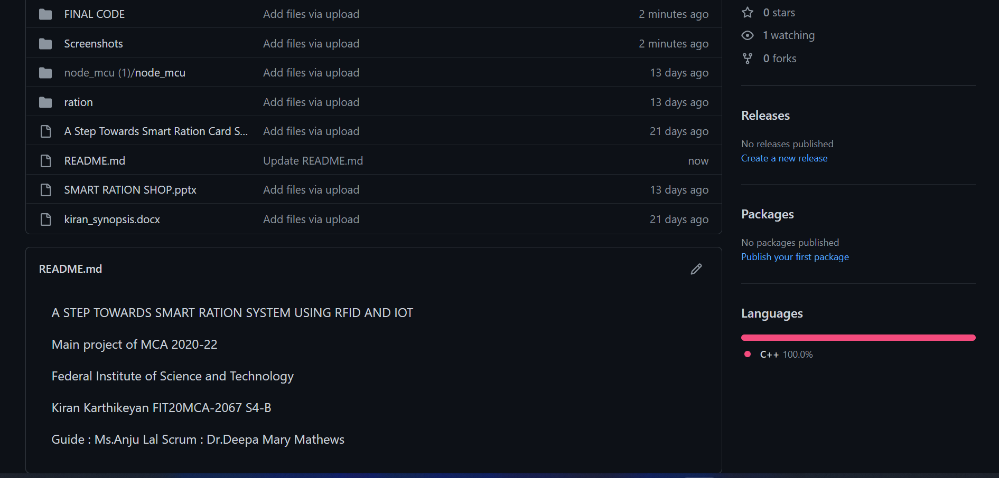
Version Control

Slide 18
References
[1] Y.A. Badamasi, “The working principle of an Arduino”, in Electronics, Computer and Computation (ICECCO), 11th International Conference on Information Communication Embedded Systems, 2014.
[2] Yerlan Berdaliyev, Alex Pappachen James, “ RFID-Cloud Smart Cart System”, IEEE Intl. Conference on Advances in Computing A Communications and Informatics (ICACCI), Sept. 21-24, 2018.
[3] Vinayak T. Shelar, Mahadev S. Patil , “RFID and GSM based Automatic Rationing System using LPC2148”, International Journal of Advanced Research in Computer Engineering & Technology (IJARCET) Volume 4 Issue 6, June 2019
[4] Bichlien Hoang, Ashley Caudill, “RFID”, IEEE Emerging Technology Portal, 2006 - 2012.

Slide 19
Thank you

